Slide 1

Individual inter-time changes
Metabolome
Lipidome
Cytokine

Slide 2
Individual inter-time changes

Slide 3
﻿Intraindividual variation of molecular profiles
﻿To understand the variation of each individual, I performed an intra-class correlation (ICC) analysis for all variables individually.
The results show that the lipidomics dataset has the highest ICC median value and thus most distinct and stable individual profiles, while the metabolome showed the lowest ICC median with a wider dispersion which means a higher intraindividual variability.

Slide 4
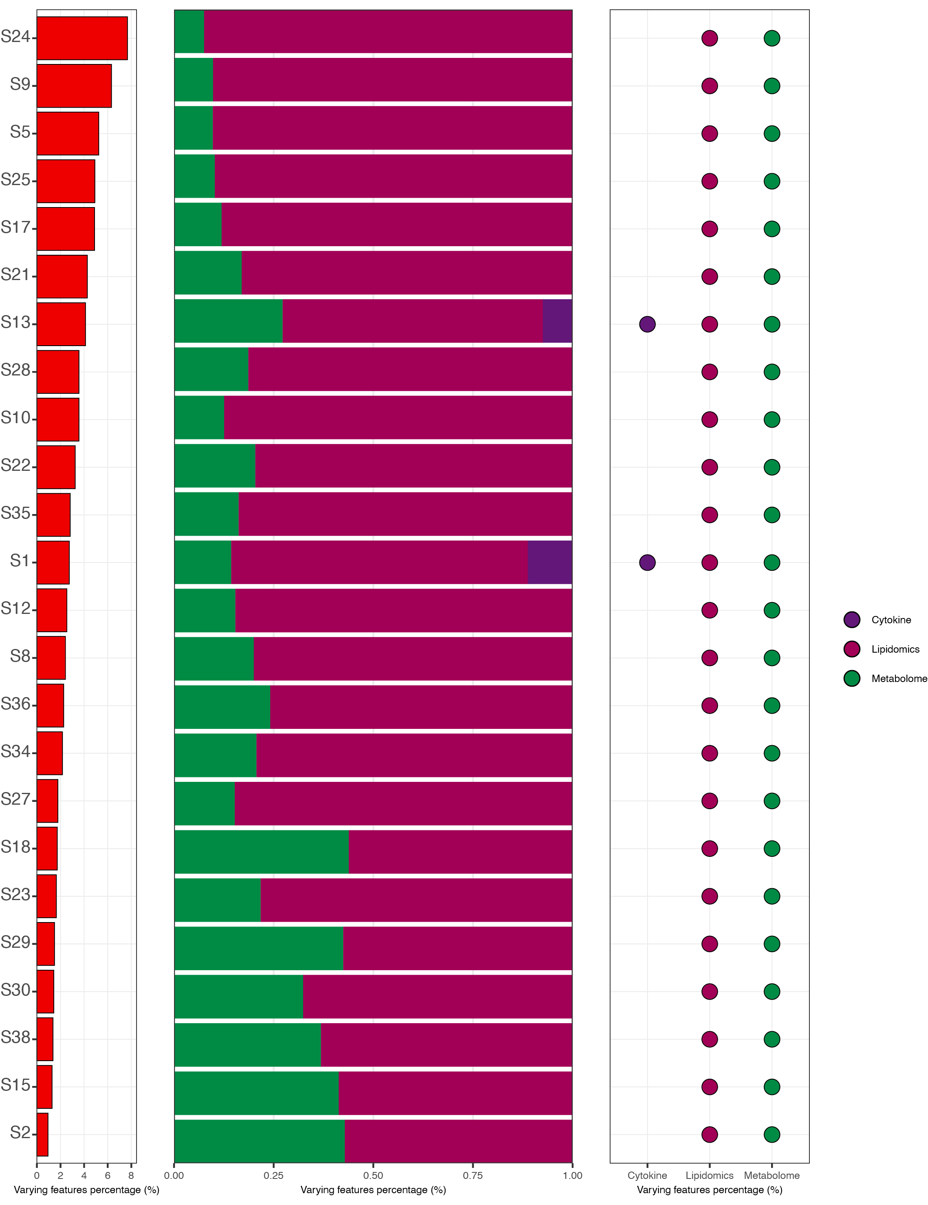
﻿Intraindividual variation of molecular profiles
Top 10 stable cytokines

Slide 5
Fuzzy c means clustering (metabolome)

Slide 6

Fuzzy c means clustering (metabolome)

Slide 7
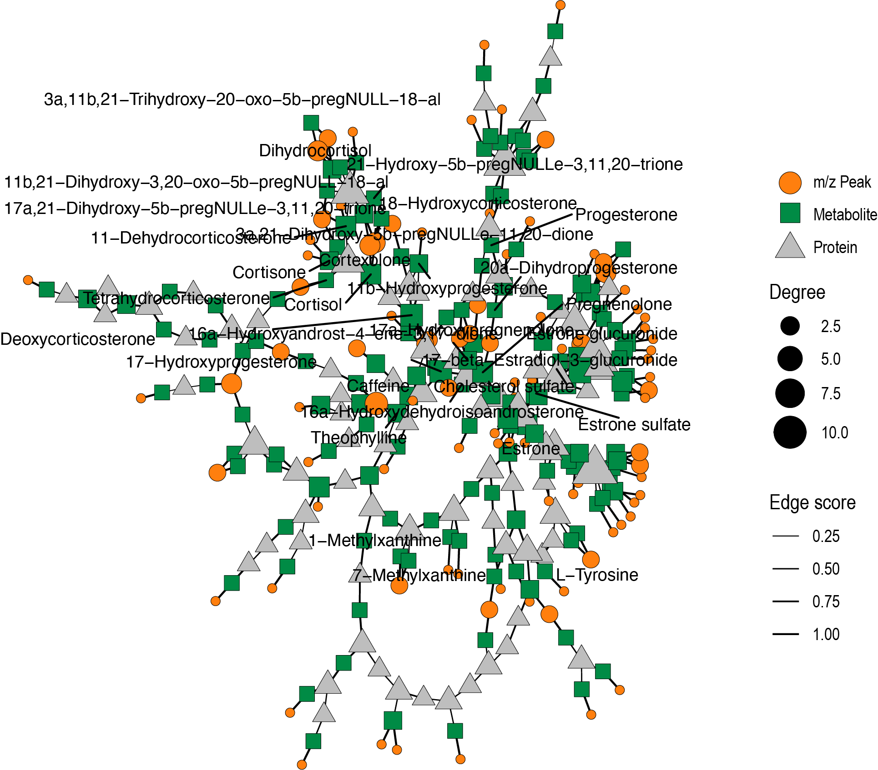
Example for functional annotation
Steroid hormone biosynthesis
Cortisol synthesis and secretion
Ovarian steroidogenesis
Caffeine metabolism
Aldosterone synthesis and secretion

Slide 8
Fuzzy c means clustering (metabolome)

Slide 9
Thanks for your attention!
Xiaotao Shen PhD
Stanford School of Medicine
Department of Genetics
shenxt@stanford.edu
@JasperShen1990
shenxt.me
github.com/jaspershen

